Slide 1
CSE 225
Data Structures and Algorithms
Instructor : Tamanna Motahar

Slide 2
Lecture 3

Slide 3
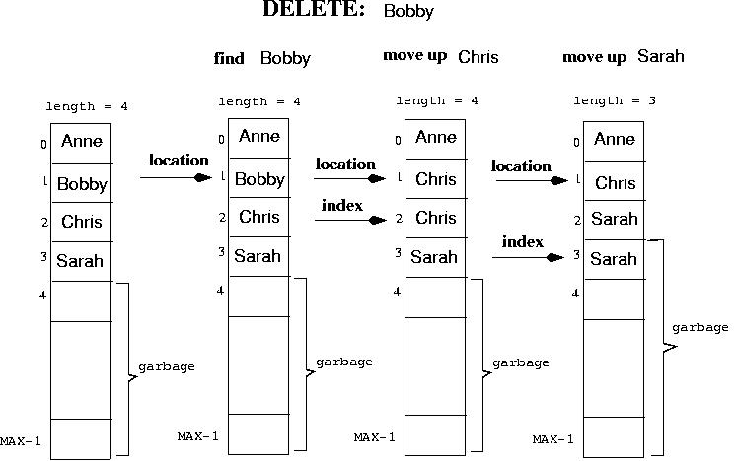
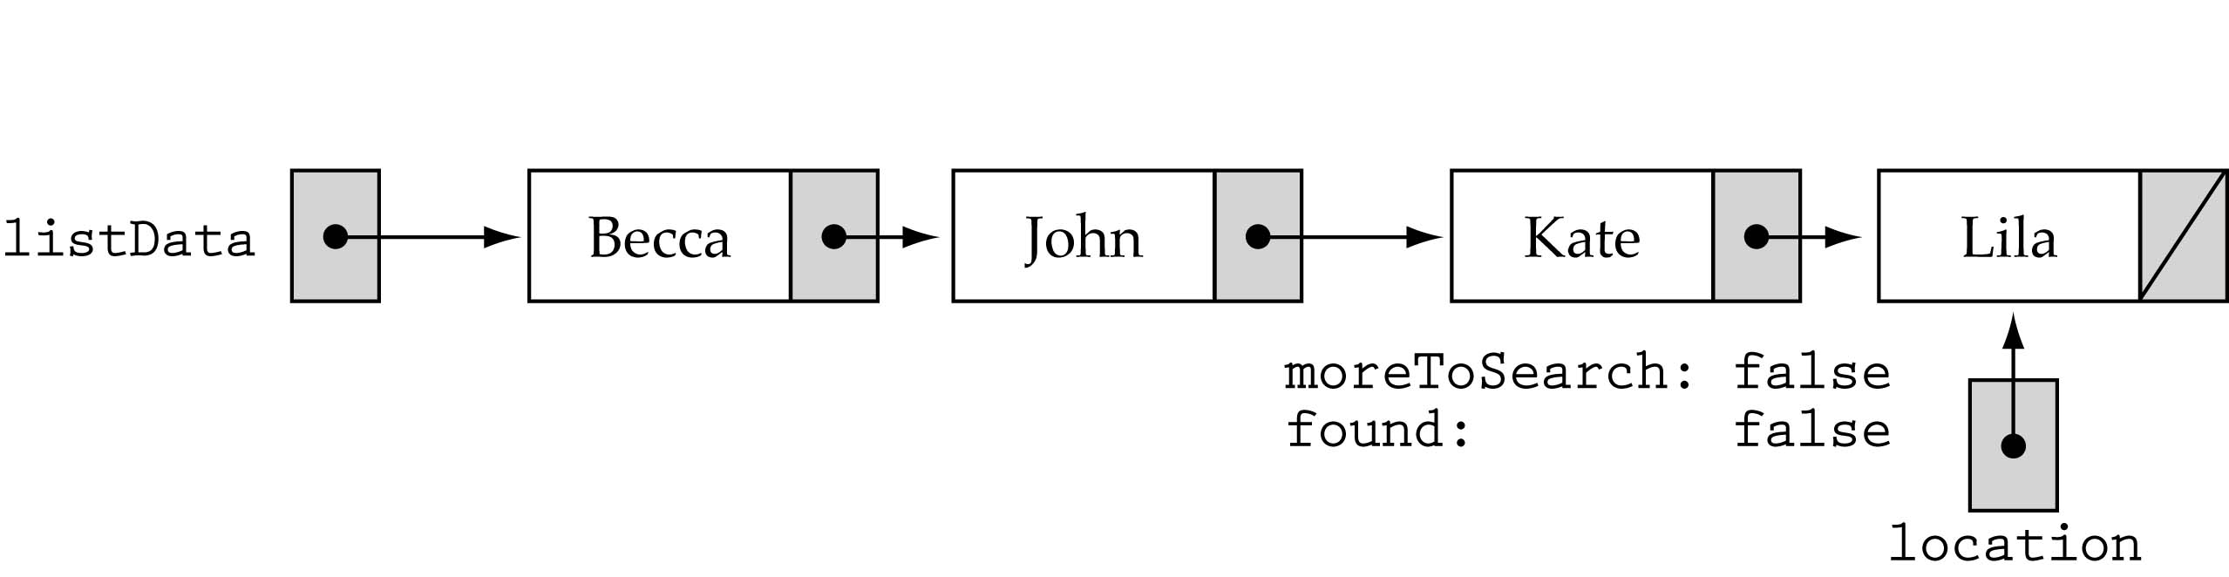
Sorted List Implementations
Array-based
Linked-list-based

Slide 4
Array-based Implementation
template<class ItemType>
class SortedType {
public:
void MakeEmpty();
bool IsFull() const;
int LengthIs() const;
void RetrieveItem(ItemType&, bool&);
void InsertItem(ItemType);
void DeleteItem(ItemType);
void ResetList();
bool IsLastItem();
void GetNextItem(ItemType&);
private:
int length;
ItemType info[MAX_ITEMS];
int currentPos;
};

Slide 5
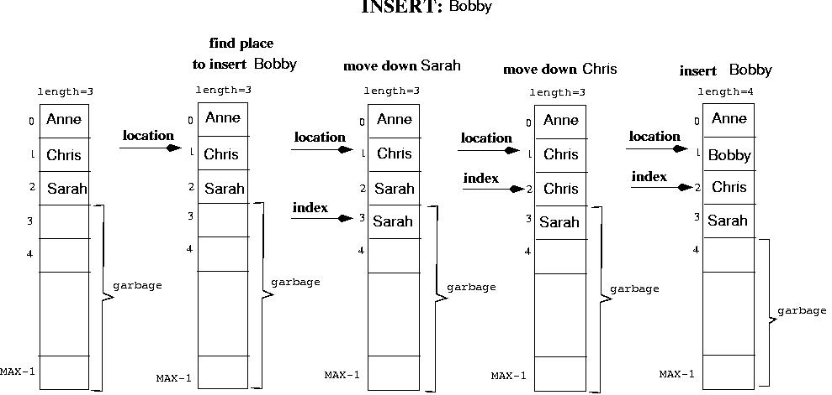

Slide 6
Array-based Implementation
template<class ItemType>
void SortedType<ItemType>::InsertItem(ItemType item)
{
int location = 0;
bool found;
found = false;
while( (location < length) && !found) {
if (item < info[location])
found = true;
else
location++;
}
for (int index = length; index > location; index--)
info[index] = info[index - 1];
info[location] = item;
length++;
}
O(N)
(cont)

Slide 7
DeleteItem
DeleteItem(ItemType item)
Function: Deletes the element whose key matches item's key
Preconditions: (1) List has been initialized, (2) Key member of item has been initialized, (3) There is only one element in list which has a key matching item's key, (4) List is sorted by key member.
Postconditions: (1) No element in list has a key matching item's key, (2) List is still sorted.

Slide 9
Array-based Implementation
template<class ItemType>
void SortedType<ItemType>::DeleteItem(ItemType item)
{
int location = 0;
while (info[location].compareto(item)!=Equal && location<length)
location++;
for (int index = location + 1; index < length; index++)
info[index - 1] = info[index];
length--;
}
O(N)

Slide 10
RetrieveItem (ItemType& item, boolean& found)
Function: Retrieves list element whose key matches item's key (if present).
Preconditions: (1) List has been initialized,
(2) Key member of item has been initialized.
Postconditions: (1) If there is an element someItem whose key matches item's key, then found=true and item is a copy of someItem; otherwise, found=false and item is unchanged, (2) List is unchanged.

Slide 11
Naive approach: use Linear Search Algorithm
item is in the list
item is not in the list
retrieve
“Sarah”
retrieve
“George”
Might not have to
search the whole list!

Slide 12
RetrieveItem()
template<class ItemType>
void SortedType<ItemType>::RetrieveItem (ItemType& item, bool& found)
{
int location = 0;
found = false;
while ( (location < length) && !found) {
if ( item > info[location]) {
location++;
else if(item < info[location])
location = length; // to break out of the loop…
else {
found = true;
item = info[location];
}
}
Still
O(N) …

Slide 13
Time Complexity
How efficient is an algorithm or piece of code? Efficiency covers lots of resources, including:
· CPU (time) usage
· memory usage
· disk usage
· network usage
**All are important but we will mostly talk about time complexity (CPU usage).

Slide 14
Time Complexity
Be careful to differentiate between:
1. Performance: how much time/memory/disk/... is actually used when a program runs . This depends on the machine, compiler, etc. as well as the code.
2. Complexity: how do the resource requirements of a program or algorithm scale, i.e., what happens as the size of the problem being solved gets larger?
Complexity affects performance but not the other way around.

Slide 15
Time Complexity
The time required by a function/procedure is proportional to the number of "basic operations" that it performs. Here are some examples of basic operations:
one arithmetic operation (e.g., +, *).
one assignment (e.g. x := 0)
one test (e.g., x = 0)
one read (of a primitive type: integer, float, character, boolean)
one write (of a primitive type: integer, float, character, boolean)

Slide 16
Time Complexity
Best Case
Average Case
Worst Case
Worst Case: What is the maximum number of
operations that might be performed for a given problem size.

Slide 17
Big O notation
We express complexity using big-O notation.
Big O notation (with a capital letter O, not a zero), is a
symbolism used in complexity theory, computer science, and mathematics to describe the asymptotic behavior of functions.
Basically, it tells you how fast a function grows or declines
The letter O is used because the rate of growth of a function is also called its order.

Slide 18
Big O notation
For a problem of size N:
a constant-time algorithm is "order 1": O(1)
a linear-time algorithm is "order N": O(N)
a quadratic-time algorithm is "order N squared": O(N²)
5n³ + 2n² + 22n + 6
= O(n³)

Slide 19
2 n^{4.1} + 200283 n⁴ + 2
= O(n^{4.1})
3 n log₂ n + 5 n log₂log₂ n
= O(n log₂ n)
n log₁₀ n⁷⁸
= O(n log₁₀ n)
log₁₀ n = log₂ n / log₂ 10
O(n log₂ n) = O(n log₁₀ n) = O(n log n)

Slide 20
Big O notation
Here is a list of classes of functions that are commonly encountered when analyzing algorithms. The slower growing functions are listed first. c is some arbitrary constant.
O(1) =constant
O(log(n)) =logarithmic
O(n) =linear
O(n²) =quadratic
O(n^{c}) =polynomial
O(c^{n}) =exponential
Note that O(n^{c}) and O(c^{n}) are very different. The latter grows much, much faster, no matter how big the constant c is.

Slide 21
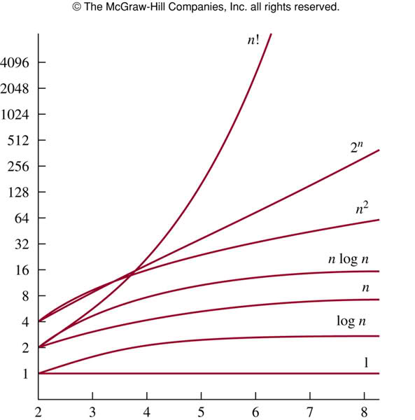

Slide 22
Big O notation
In general, how can you determine the running time of a piece of code? The answer is that it depends on what kinds of statements are used.
Sequence of statements
statement 1;
statement 2;
...
statement k;
The total time is found by adding the times for all statements:
total time = time(statement 1) + time(statement 2) + ... + time(statement k)
If each statement is "simple" (only involves basic operations) then the time for each
statement is constant and the total time is also constant: O(1).

Slide 23
Big O notation
If-Then-Else
if (cond) then
block 1 (sequence of statements)
else
block 2 (sequence of statements)
end if;
Here, either block 1 will execute, or block 2 will execute. Therefore, the worst-case time is the slower of the two possibilities:
max(time(block 1), time(block 2))
If block 1 takes O(1) and block 2 takes O(N), the if-then-else statement would be O(N).

Slide 24
Big O notation
Loops
for I in 1 .. N loop
sequence of statements
end loop;
The loop executes N times, so the sequence of statements also executes N times. If we
assume the statements are O(1), the total time for the for loop is N * O(1), which is O(N)
overall.

Slide 25
Big O notation
Nested loops
for I in 1 .. N loop
for J in 1 .. M loop
sequence of statements
end loop;
end loop;
The outer loop executes N times. Every time the outer loop executes, the inner loop
executes M times. As a result, the statements in the inner loop execute a total of N * M times. Thus, the complexity is O(N * M).

Slide 26
Big O notation
In a common special case where the stopping condition of the inner loop is J<N instead Of J<M (i.e., the inner loop also executes N times), the total complexity for the two loops is O(N²).
Statements with function/ procedure calls
When a statement involves a function/ procedure call, the complexity of the statement includes the complexity of the function/ procedure.

Slide 27
Big O notation
Statements with function/ procedure calls
When a statement involves a function/ procedure call, the complexity of the statement includes the complexity of the function/ procedure.
Assume that you know that function/ procedure f takes constant time, and that function/procedure g takes time proportional to (linear in) the value of its parameter k. Then the statements below have the time complexities indicated.
f(k) has O(1)
g(k) has O(k)
When a loop is involved, the same rule applies. For example:
for J in 1 .. N loop
g(J);
end loop;
The loop executes N times and each function/procedure call g(N), so total complexity O(N²)

Slide 28
Some Results
Sum of two functions: If f(n) = f₁(n) + f₂(n), and f₁(n) is O(g₁(n)) and f₂(n) is O(g₂(n)), then f(n) = O(max(|g₁(n)|, |g₂(n)|)).
Product of two functions: If f(n) = f₁(n)* f₂(n), and f₁(n) is O(g₁(n)) and f₂(n) is O(g₂(n)), then f(n) = O(g₁(n)* g₂(n)).

Slide 29
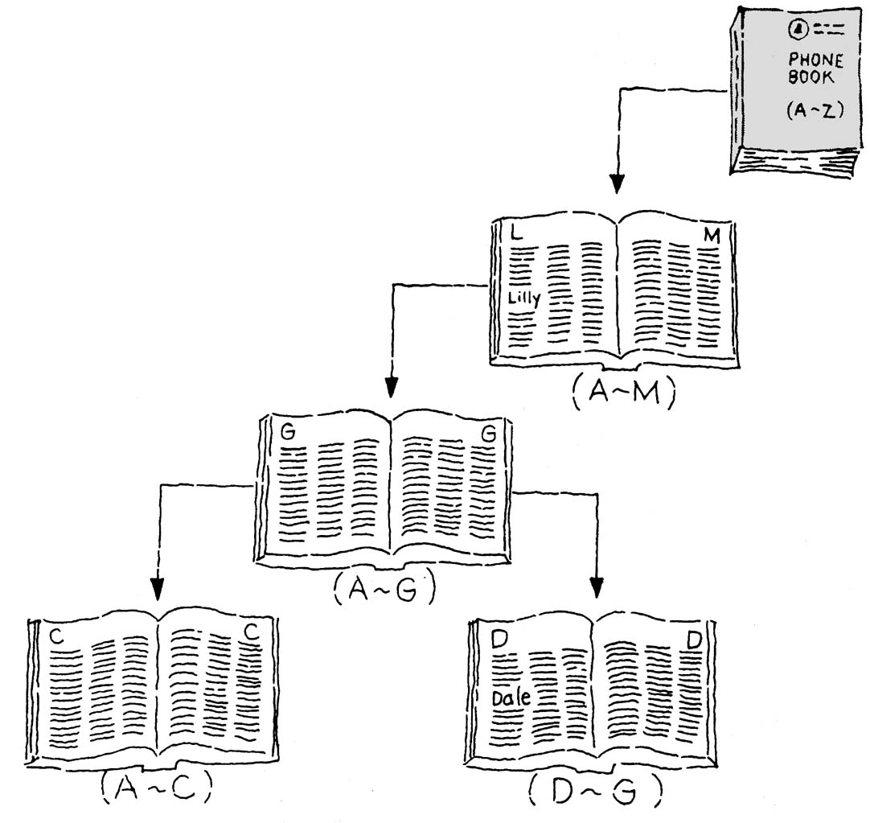
Binary Search Algorithm
Split the current search area in half, and if the item is not found there, then search the appropriate half.

Slide 30
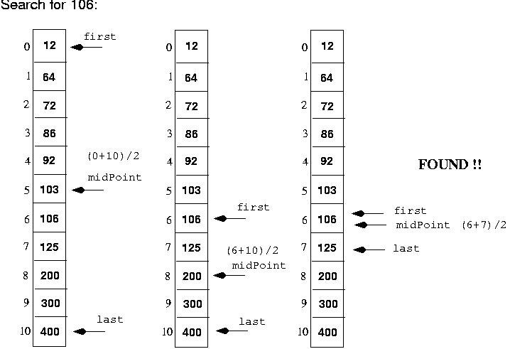

Slide 31
Binary Search Algorithm (cont.)
template<class ItemType>
void SortedType<ItemType>::
RetrieveItem(ItemType& item, bool& found)
{
int midPoint;
int first = 0;
int last = length - 1;
found = false;
while( (first <= last) && !found) {
midPoint = (first + last) / 2;
if (item < info[midPoint])
last = midPoint - 1;
else if(item > info[midPoint])
first = midPoint + 1;
else {
found = true;
item = info[midPoint];
}
}
}
O(logN)

Slide 32
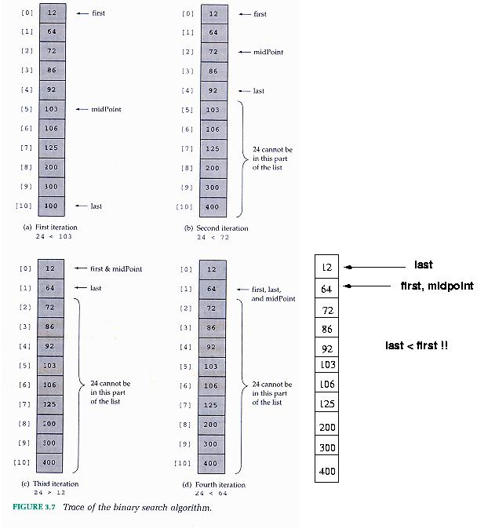
- Search for 24:

Slide 33
Binary Search Efficiency
(1) Number of iterations:
For a list of 11 elements, it never iterates more than 4 times (e.g., approximately log₂ 11 times).
Linear Search can iterate up to 11 times.
Number of Iterations
List Length | Linear Search (average) | Binary Search
10 | 5.5 | 3.3
100 | 50.5 | 6.6
1,000 | 500.5 | 10
10,000 | 5000.5 | 13.3

Slide 34
Binary Search Efficiency (cont’d)
(2) Number of computations per iteration:
Binary search does more work per iteration than Linear Search
Linear search iterations
Binary search iterations
while ( (location < length) && !found) {
if ( item > info[location]) {
location++;
else if(item < info[location])
location = length; // to break out of the loop…
else {
found = true;
item = info[location];
}
}
while( (first <= last) && !found) {
midPoint = (first + last) / 2;
if (item < info[midPoint])
last = midPoint - 1;
else if(item > info[midPoint])
first = midPoint + 1;
else {
found = true;
item = info[midPoint];
}

Slide 35
List Implementations
Big-O Comparison of List Operations
Operation | Unsorted | Sorted
MakeEmpty | O(1) | O(1)
LengthIs | O(1) | O(1)
IsFull | O(1) | O(1)
ResetList | O(1) | O(1)
GetNextItem | O(1) | O(1)
RetrieveItem | O(N) | O(log N)
InsertItem | O(1) | O(N)
DeleteItem | O(N) | O(N)

